Slide 1
Random Variable Definition
A random variable is a rule that assigns a numerical value to each outcome in a sample space.
Random variables may be either discrete or continuous. A random variable is said to be discrete if it assumes only specified values in an interval.
Otherwise, it is continuous.
We generally denote the random variables with capital letters such as X and Y.
When X takes values 1, 2, 3, …, it is said to have a discrete random variable.

Slide 2
Variate
A variate can be defined as a generalization of the random variable.
It has the same properties as that of the random variables without stressing to any particular type of probabilistic experiment.
It always obeys a particular probabilistic law.
A variate is called discrete variate when that variate is not capable of assuming all the values in the provided range.
If the variate is able to assume all the numerical values provided in the whole range, then it is called continuous variate.

Slide 3
Types of Random Variable
As discussed in the introduction, there are two random variables, such as:
Discrete Random Variable
Continuous Random Variable
Discrete Random Variable
A discrete random variable can take only a finite number of distinct values such as 0, 1, 2, 3, 4, … and so on. The probability distribution of a random variable has a list of probabilities compared with each of its possible values known as probability mass function.

Slide 4
Continuous Random Variable
A numerically valued variable is said to be continuous if, in any unit of measurement, whenever it can take on the values a and b.
If the random variable X can assume an infinite and uncountable set of values, it is said to be a continuous random variable.
When X takes any value in a given interval (a, b), it is said to be a continuous random variable in that interval.

Slide 5
Random Variable Formula
For a given set of data the mean and variance random variable is calculated by the formula. So, here we will define two major formulas:
Mean of random variable
Variance of random variable

Slide 6
Mean of random variable:
If X is the random variable and P is the respective probabilities, the mean of a random variable is defined by:
Mean (μ) = ∑ XP
where variable X consists of all possible values and P consist of respective probabilities.

Slide 7
Variance of Random Variable:
The variance tells how much is the spread of random variable X around the mean value. The formula for the variance of a random variable is given by;
Var(X) = σ² = E(X²) – [E(X)]²
where E(X²) = ∑X²P and E(X) = ∑ XP

Slide 8
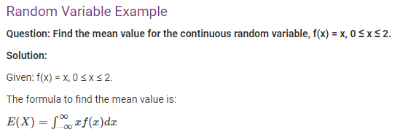
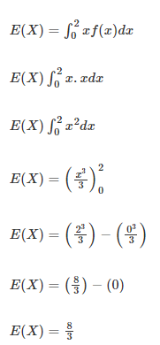

Slide 9
What is meant by a random variable?
Solution:-
A random variable is a rule that assigns a numerical value to each outcome in a sample space, or it can be defined as a variable whose value is unknown or a function that gives numerical values to each of an experiment’s outcomes.

Slide 10
What is a random variable and its types?
Solution:-
As we know, a random variable is a rule or function that assigns a numerical value to each outcome of the experiment in a sample space.
There are two types of random variables,
i.e. discrete and continuous random variables.

Slide 11
How do you identify a random variable?
Solution:-
In general, random variables are represented by capital letters for example, X and Y.

Slide 12
How do you know whether a random variable is continuous or discrete?
A discrete variable is a variable whose value can be obtained by counting since it contains a possible number of values that we can count. In contrast, a continuous variable is a variable whose value is obtained by measuring.

Slide 13
What are the examples of a discrete random variable?
Solution:-
The probability of any event in an experiment is a number between 0 and 1, and the sum of all the probabilities of the experiment is equal to 1. Examples of discrete random variables include the number of outcomes in a rolling die, the number of outcomes in drawing a jack of spades from a deck of cards and so on.

Slide 14
Moment Generating Functions
Moment generating functions are useful for several reasons, one of which is their application to analysis of sums of random variables. Before discussing MGFs, let's define moments.
Definition The nth moment of a random variable X is defined to be
For example, the first moment is the expected value E[X].
The second central moment is the variance of X.
Similar to mean and variance, other moments give useful information about random variables.

Slide 15
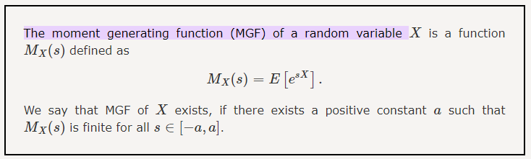
Example For each of the following random variables, find the MGF.

Slide 16
